Slide 1

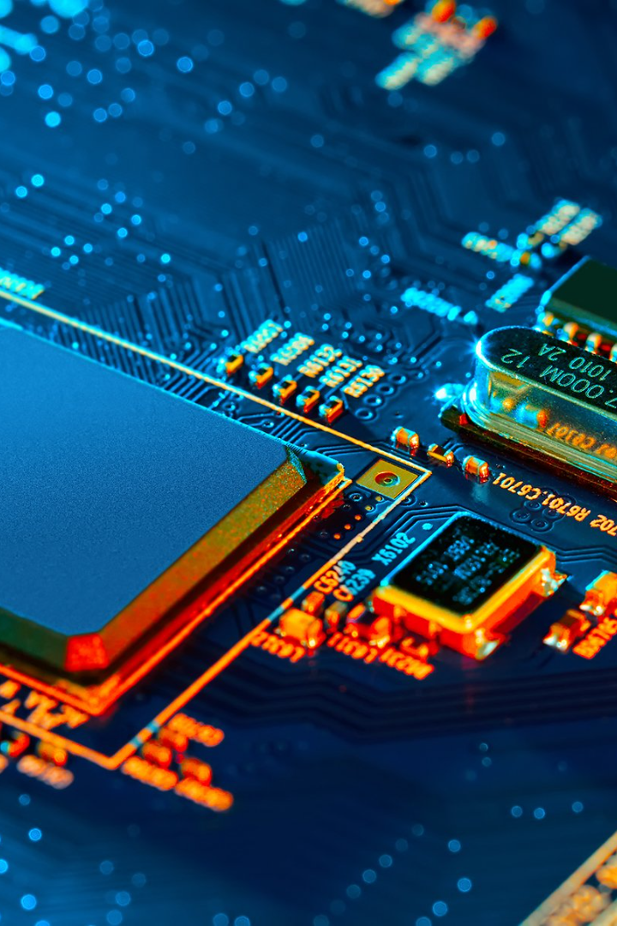
Serverless IoT Data Processing
In this part you will continue building your project. Learn how to process and store data with IBM Cloud Functions and Cloud Object Storage.

Slide 2
Processing Data in Real-Time
1
Connect Your Device
Connect your device to IBM Cloud to start streaming data directly to IBM Cloud Functions.
2
Apply Functions
Use pre-built functions to transform incoming data, filter out noise, and make calculations automatically.
3
Trigger Routines
Create automated routines to alert you when thresholds are reached, trends are identified, or patterns are recognized.
4
Real-Time Insights
Enable real-time insights and visualize results with the IBM Cloud platform.

Slide 3
Automation for Efficiency
Automate Processes
Eliminate Errors
Use automation to streamline processes and save time, increasing efficiency and effectiveness.
Reduce manual input and eliminate human error by automating routine tasks.
Improve Quality
Empower Teams
Improve quality of results by leveraging pre-built automation tools and templates.
Empower teams with the ability to focus on high-value tasks and innovation.

Slide 4
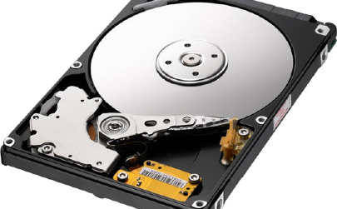
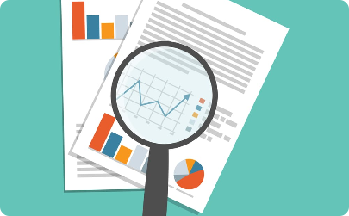
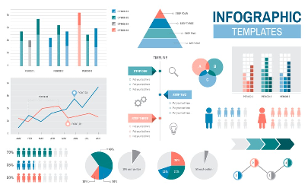
Storage and Analysis with Object Storage
Secure Storage
Flexible Access
Data Analysis
Store your data securely in IBM Cloud Object Storage, providing encrypted, redundant, and scalable storage.
Access your data in IBM Cloud Object Storage from anywhere, anytime from multiple devices and applications.
Analyze your data in-place with querying and transformational services, unlocking insights and intelligence in your data.

Slide 5

Benefits of Serverless IoT Data Processing
1
Efficient
Optimize your processes and increase your efficiency with automated routines and data processing.
2
Scalable
Scale your solution according to your needs to process as much data as you need, when you need it.
3
Cost-effective
Easily adjust your processing capacities based on data volumes, avoiding overprovisioning and overpaying.

Slide 6
Real-Life Applications of Serverless IoT Data Processing
1
Smart City Planning
Use smart sensors and automated data processing to optimize traffic flow and parking in your city.
Environmental Monitoring
2
Use connected devices and data processing to monitor air quality, pollution, and waste management.
3
Manufacturing Optimization
Use IoT data processing to optimize your manufacturing processes and improve the quality of your products.

Slide 7

Challenges and Considerations
Data Privacy
Data Quality
System Integration
Ensure compliance with data privacy regulations and protect your data at every step of the data processing cycle.
Configure your system to handle and filter out noisy data, ensuring the accuracy and usefulness of your results.
Integrate your IoT devices, automation, and storage seamlessly for a robust and comprehensive solution.

Slide 8
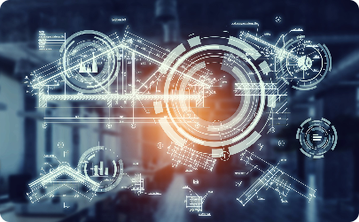
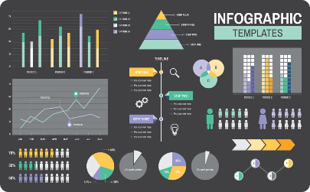

Conclusion
Unleash Your Innovation
Unlock Insights
Collaborate and Scale
Take advantage of the latest serverless and IoT technologies to drive innovation and growth in your business.
Unlock deep insights into your data with real-time processing and analysis, empowering you to make informed decisions.
Collaborate effectively and scale easily with IBM Cloud's serverless and IoT solutions, no matter your level of expertise.

